Slide 1

Research Data Management Platform
Health Informatics Centre

Slide 2
RDMP Data Linkage Services Core Features
Data
Repository
Data Feeds
(e.g. SMR01, Vascular Lab)
RDMP Data Load & Curation
RDMP Cohort Builder
RDMP
Project Extraction Services
Anonymous
Extract
(Plus Metadata)
Cohort
Features
Audit
Release
Documents
Reproducibility
Validation
Drag and Drop
Summarisation
Governance
SQL Code Management
Extraction Policy Management

Slide 3
RDMP Data Linkage Services Core Features
Data
Repository
Data Feeds
(e.g. SMR01, Vascular Lab)
RDMP Data Load & Curation
RDMP Cohort Builder
RDMP
Project Extraction Services
Anonymous
Extract
(Plus Metadata)
Cohort
Features
Audit
Release
Documents
Reproducibility
Validation
Drag and Drop
Summarisation
Governance
SQL Code Management
Extraction Policy Management

Slide 4
RDMP Demo Break

Slide 5
RDMP Data Linkage Services Core Features
Data
Repository
Data Feeds
(e.g. SMR01, Vascular Lab)
RDMP Data Load & Curation
RDMP Cohort Builder
RDMP
Project Extraction Services
Anonymous
Extract
(Plus Metadata)
Cohort
Features
Audit
Release
Documents
Reproducibility
Validation
Drag and Drop
Summarisation
Governance
SQL Code Management
Extraction Policy Management

Slide 6
RDMP Demo Break

Slide 7
Advanced Cohort Example

Slide 8
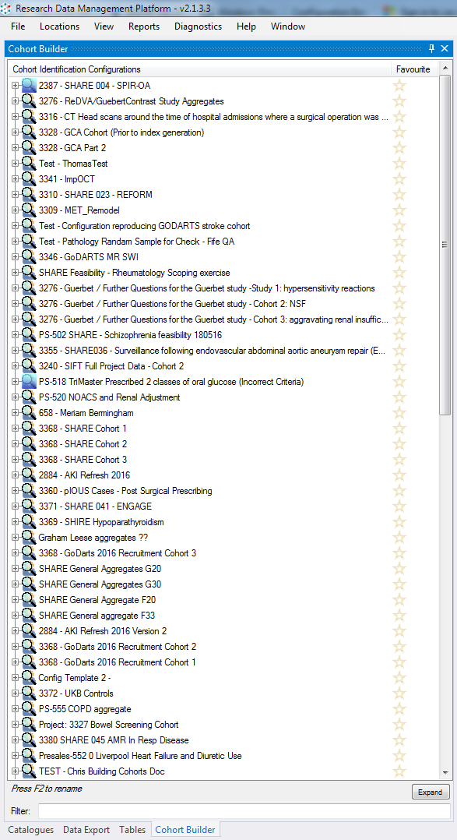
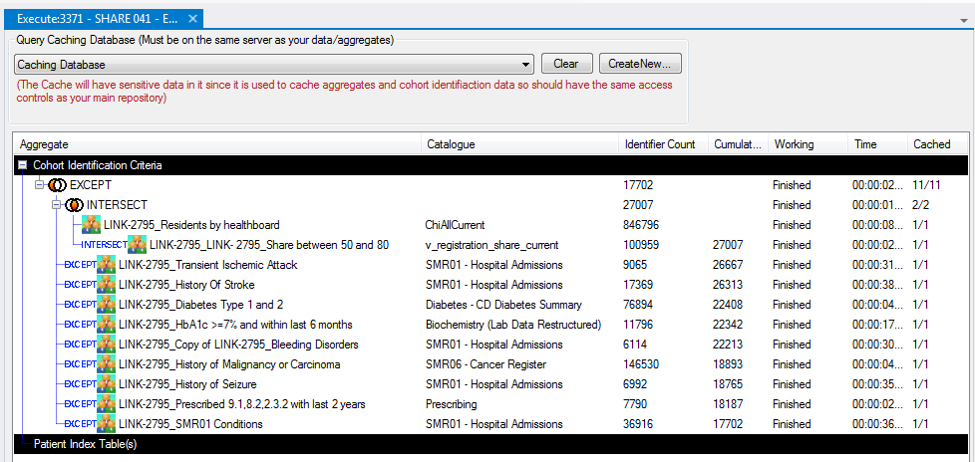

Slide 9
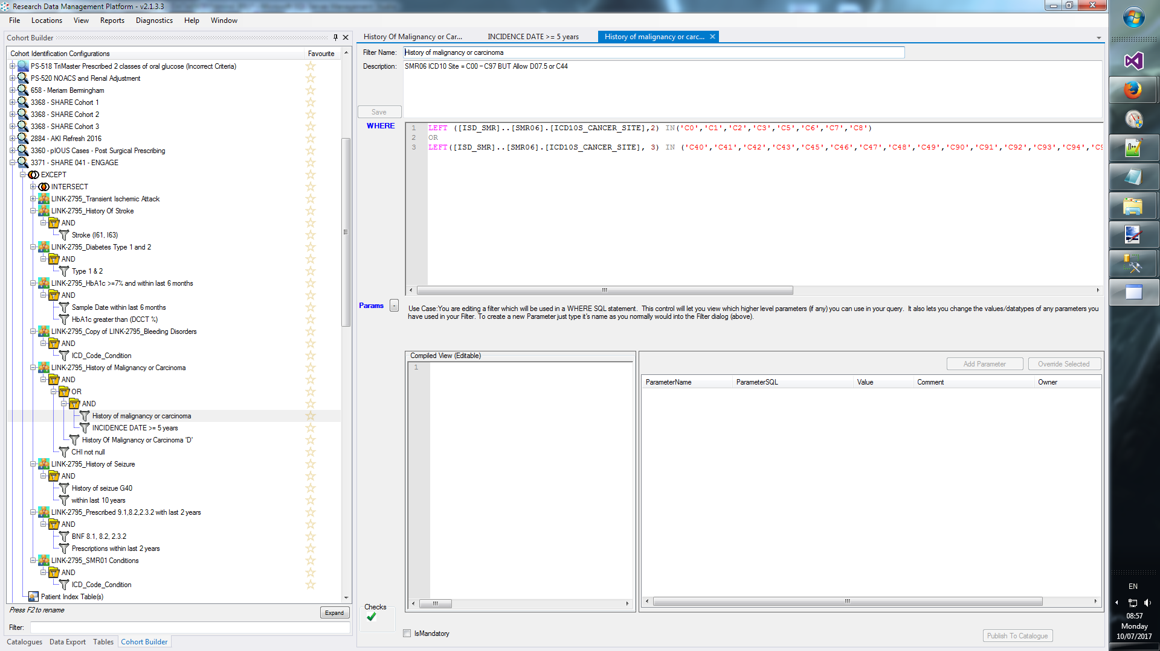

Slide 10
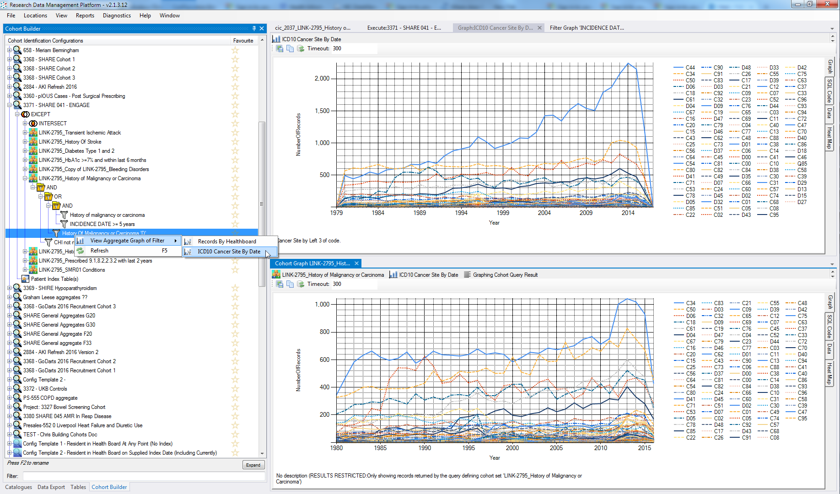

Slide 11
RDMP Data Linkage Services Core Features
Data
Repository
Data Feeds
(e.g. SMR01, Vascular Lab)
RDMP Data Load & Curation
RDMP Cohort Builder
RDMP
Project Extraction Services
Anonymous
Extract
(Plus Metadata)
Cohort
Features
Audit
Release
Documents
Reproducibility
Validation
Drag and Drop
Summarisation
Governance
SQL Code Management
Extraction Policy Management

Slide 12
RDMP Demo Break
Import File, Configure column extracts, anonymization, documentation

Slide 13
Data Set and Extraction Policy Management
Dataset Extraction Rules
Which columns are extracted
Which columns require special approval
Which columns are Never Extractable
Mandatory Filtering (only extract Tayside and Fife Healthboards)
Predefined filter templates
Anonymisation Rules (project specific):
Dilution ( DD1 ), Hashing (fe34ga7345) and Substitution ( T1010 -> A23299)
Dashboard Aggregates Graphs
Quality Metrics (e.g. CHI 100%, Condition Codes > 90%)
Important Meta data document attachments

Slide 14
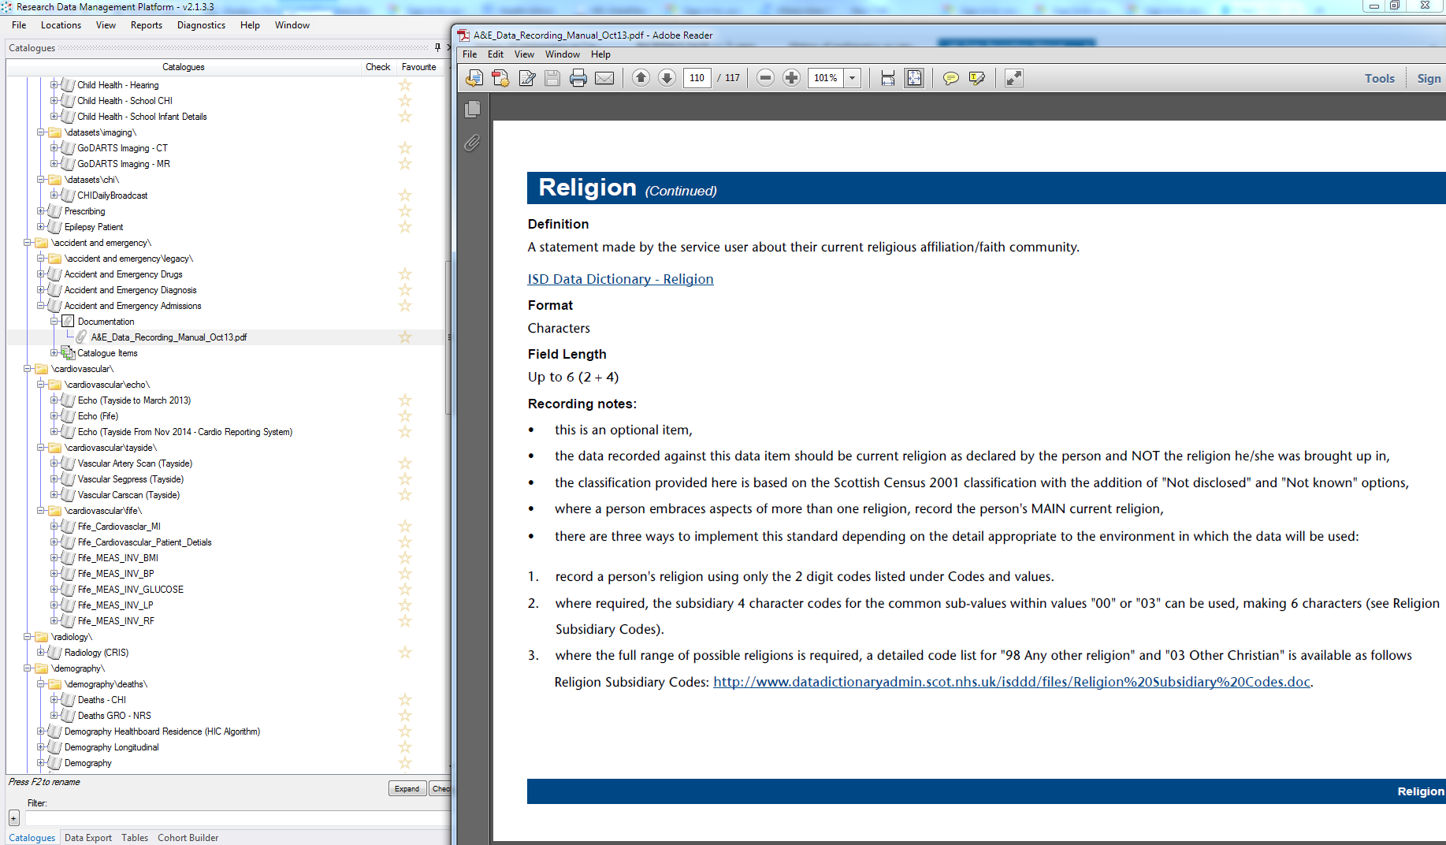

Slide 15
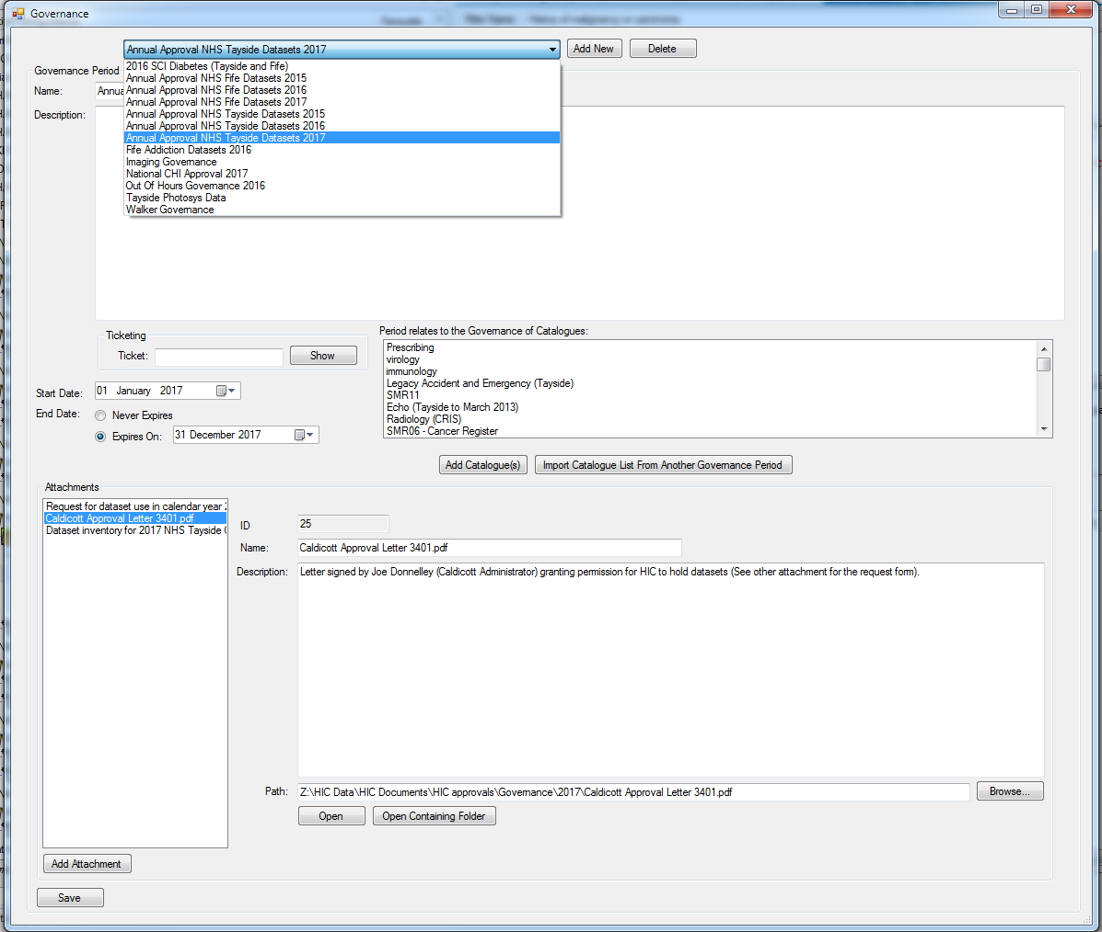

Slide 16
Audit
Every Extraction, Data Load, Data Quality Engine run etc
Extraction Queries
Number of records extracted / loaded etc
Who performed action
Extract location
MD5

Slide 17
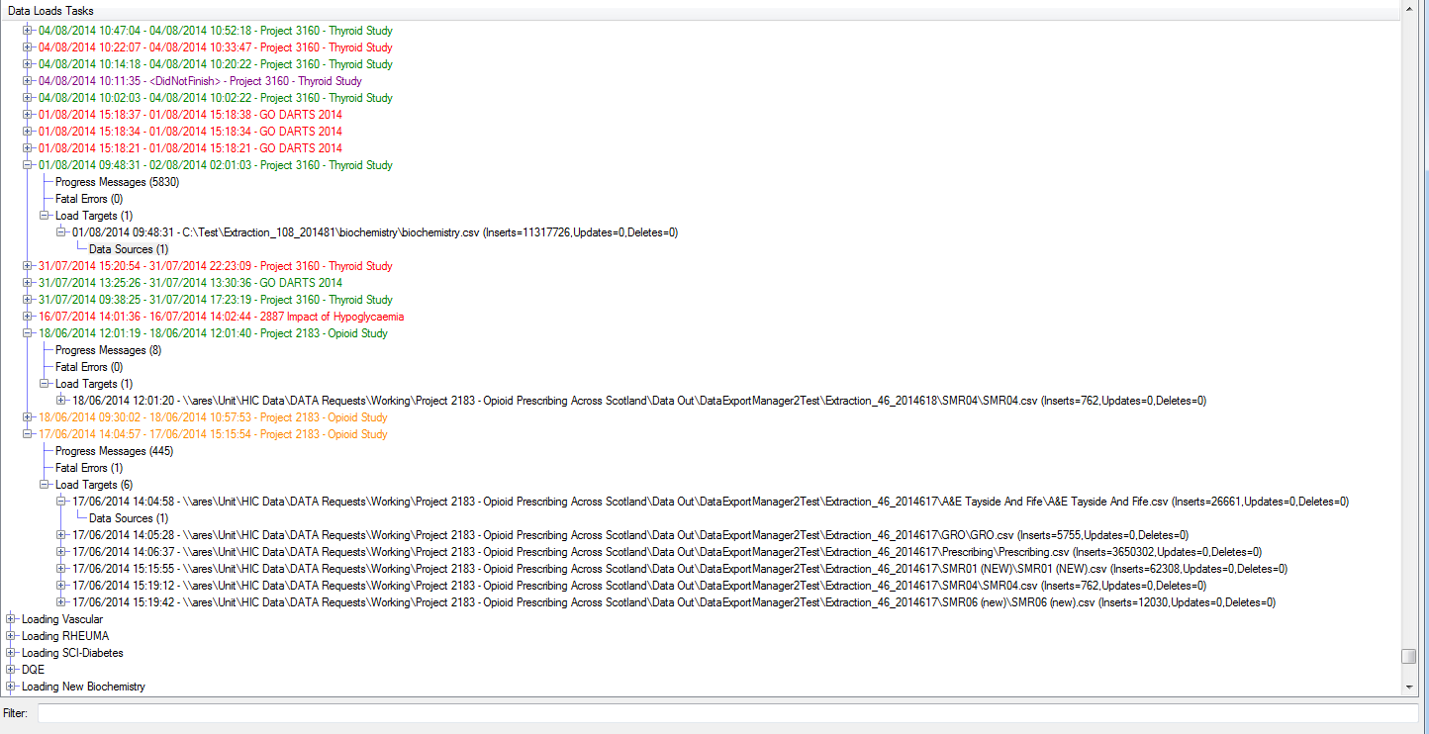

Slide 18
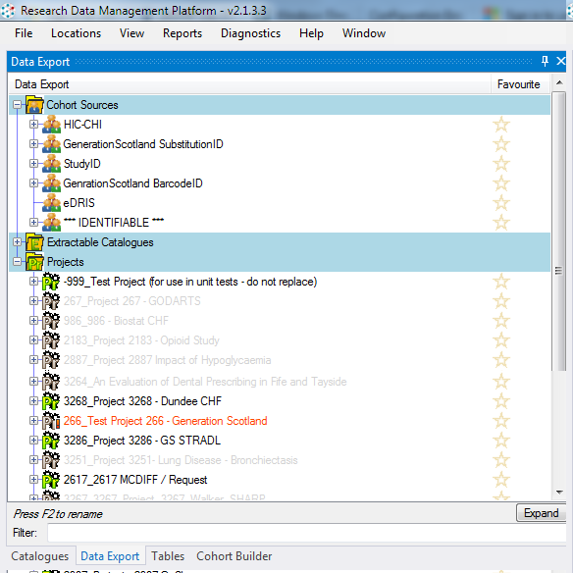
CHI => PROCHI
CHI => Generation Scotland ID
CHI => eDRIS Identifier
Released Projects
Projects with active extracts being built

Slide 19
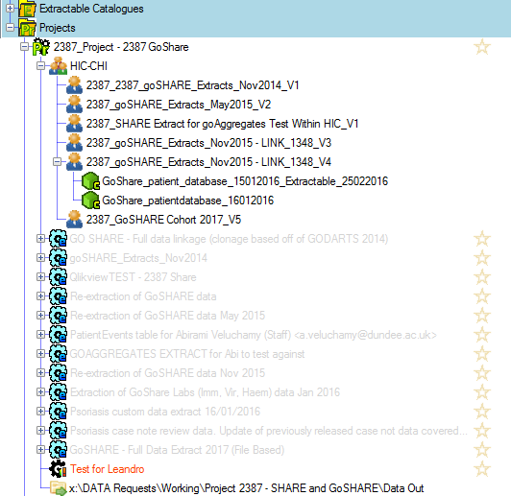
Within a Project:
Multiple cohort snapshots over time
Project/Cohort Specific Data Tables
Configurations (which datasets were extracted)
Were there any filters?

